Slide 1
AI for Kids
UK Robotics Week 2024

Slide 2
This Story is about my stories about the superhero who's trying to use generative AI ethically and efficiently
This story is created by:
John
Manal
Mary

Slide 3
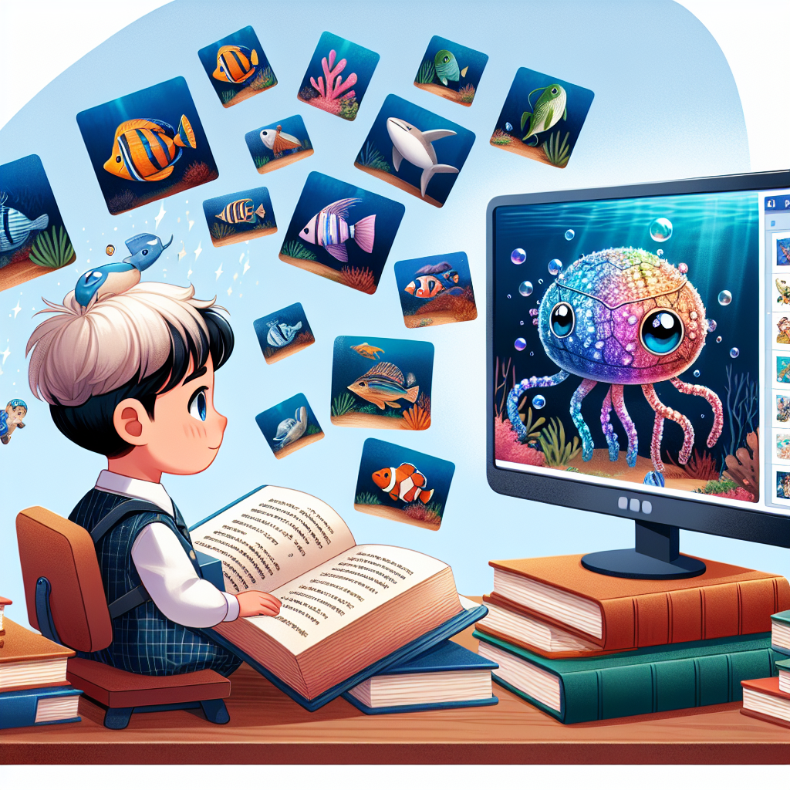
That sounds like an exciting adventure! Learning about ocean life with AI can be fun. You can use AI to
analyze data and discover new things about marine creatures. Do you know any sea creatures you want to learn more about?
Illustrate a children's storybook scene featuring a primary school child, hailing from a Hispanic background, with a spark of curiosity. The child is studying with great determination, aspiring to be an ocean scientist. The books around them are filled with images of marine life and underwater landscapes. Off to the side, there's a computer screen displaying an Artificial Intelligence program, showing it generating vibrant images of unique creatures from the deep sea, unseen before.

Slide 4
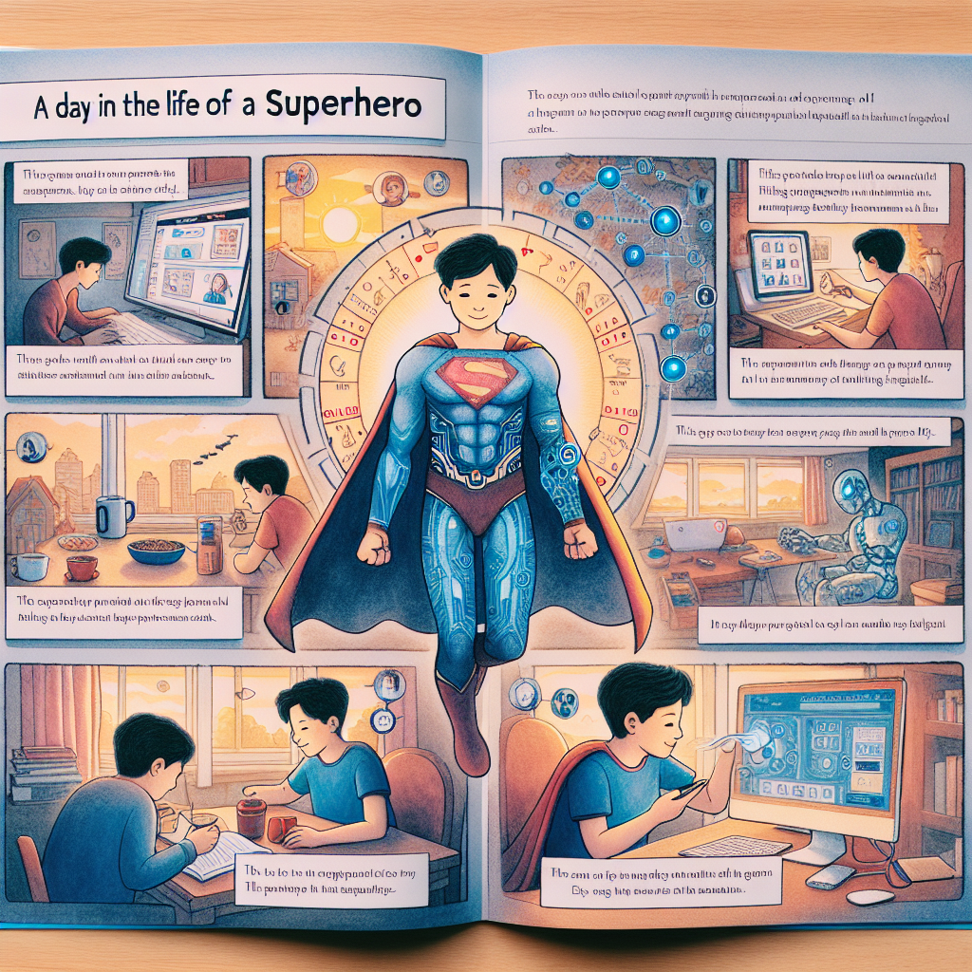
Sure! In the story, the superhero learns about the importance of teamwork and collaboration with AI to explore and understand the ocean's mysteries. The generative AI helps the superhero analyze data, make predictions,
and discover new species in the deep sea. Through this partnership, the superhero not only becomes a skilled ocean scientist but also develops a deeper appreciation for the wonders of the underwater world.
An image of a narrative, showcasing a day in the life of a superhero. The superhero is seen embracing the technology of Generative AI throughout his day. The page starts with a scene of him waking up in the morning with the assistance of AI, using it further to make breakfast. He then relies on AI to travel to school and engage in active learning throughout his sessions. After school, the AI assists him in completing his homework. The day ends with a warm scene where he uses his AI to aid his family in their daily chores and communicate effectively. The sequence provides a glimpse into the superhero's life, delineating the crucial role of Generative AI.

Slide 5
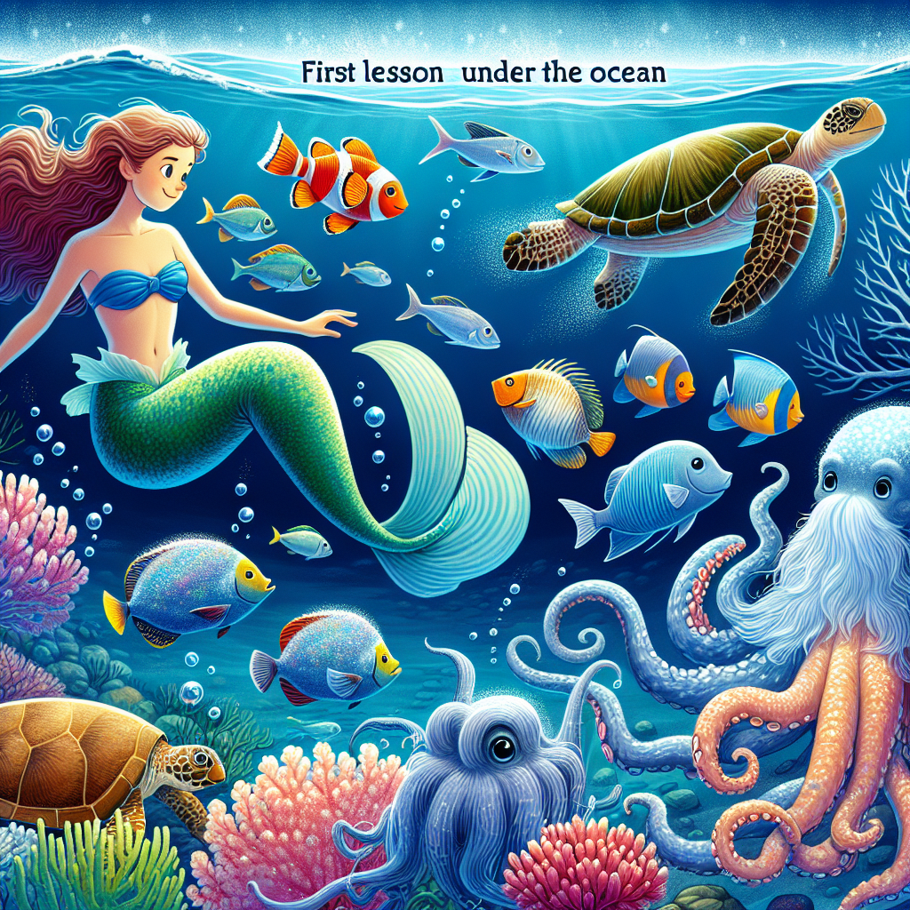
In the ocean, our young scientist learns about vibrant coral reefs filled with various fish species using generative AI. He marvels at the intricate patterns and vivid colors of the underwater world. With the help of AI, he discovers the unique characteristics of sea creatures like the agile octopus, the
graceful sea turtles, and the camouflaging cuttlefish. Through interactive lessons, he explores how AI can simulate the movements and behaviors of these remarkable organisms, broadening his understanding of marine life. With each discovery, his passion for ocean exploration grows, fueled by the endless possibilities AI offers in understanding our underwater ecosystems.
Create an engaging and educational image for a children's story book. This image should depict the first lesson about life under the ocean. Show different organisms that live beneath the water surface and exhibit their characteristics distinctly. Include a variety of oceanic creatures like a Caucasian mermaid with her vibrant orange fish tail, a large, aged sea turtle, a school of shimmering silver fish swimming together, a Hispanic diver, a friendly giant octopus with jelly-like tentacles, and a cluster of colorful coral reefs. The background should represent the deep blue sea filled with mystic and beauty.

Slide 6
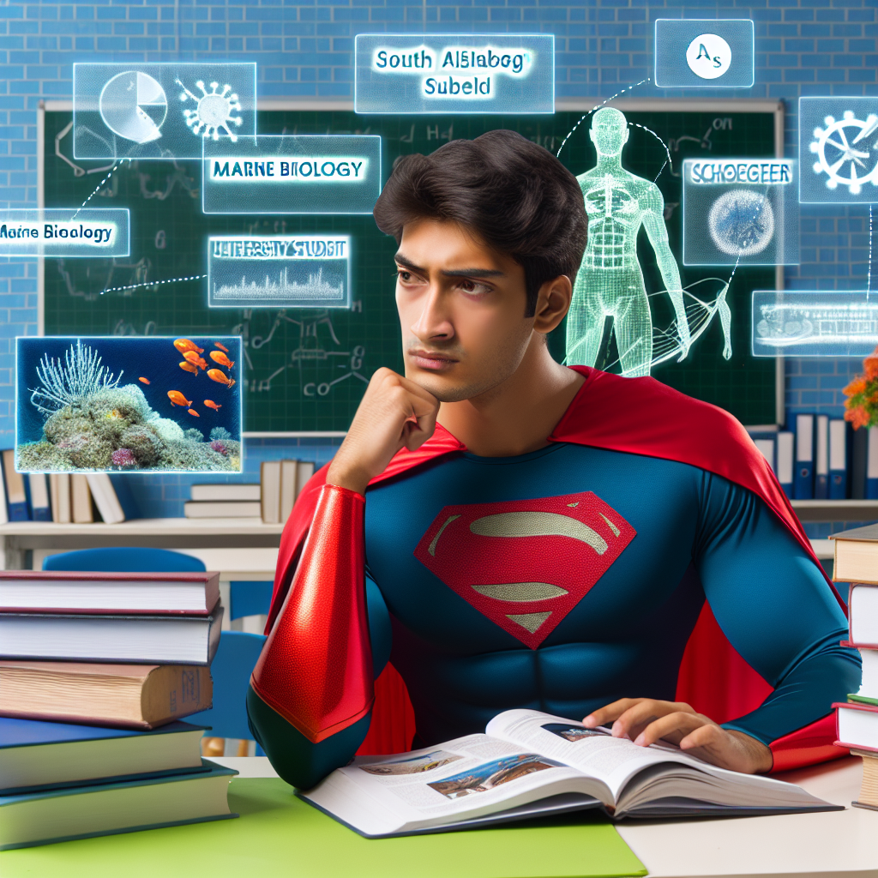
In the first lesson, the superhero dives into the ocean to explore various organisms like colorful fish, coral reefs, and mysterious sea creatures. Each organism has unique characteristics that fascinate the superhero, sparking a curiosity for marine life. At high
school, the superhero can focus on biology, environmental science, and computer programming to prepare for university studies in marine biology. These subjects will provide a solid foundation to understand ocean ecosystems and work alongside generative AI in research and exploration.
Create an image of a high school setting where a young superhero, who is a South Asian male, is seen contemplating his A-level subject choices. He's surrounded by various textbooks and info-graphics related to marine biology, signaling his interest in this field for future university studies. Highlight the intensity on his face as he makes a decision that will greatly impact his future.

Slide 7
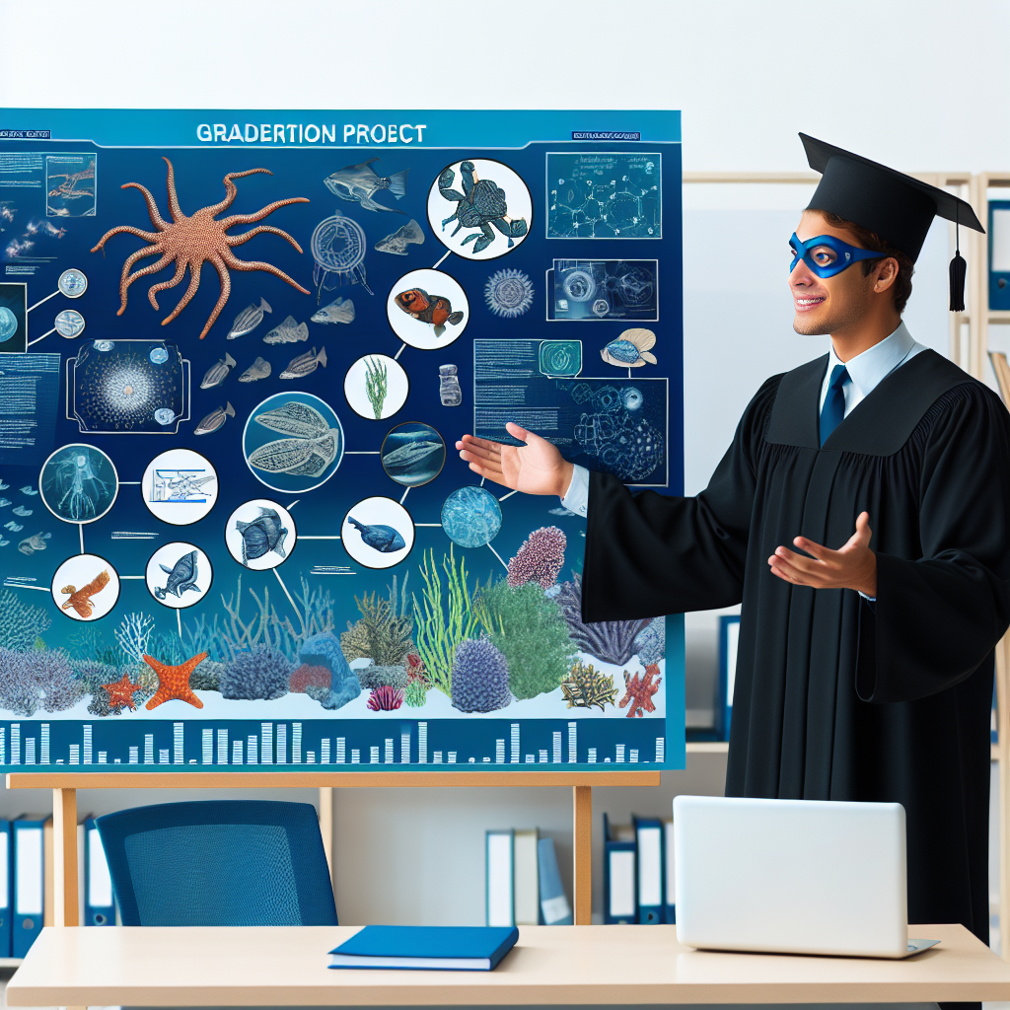
In the beginning, our young hero is fascinated by underwater creatures and learns about marine life using generative AI. The hero seamlessly integrates AI into daily activities like studying and communicating. As the hero progresses to
high school, they consider focusing on marine biology for university studies. Finally, in university, the hero embarks on a graduation project exploring cutting-edge advancements in marine life, showcasing the profound impact of AI on underwater exploration.
Create an image of a superhero-themed graduation project in a university setting that focuses on the latest advances in marine life. The project could be an elaborate poster illustrating various underwater species and their environment along with the technological advancements aiding in their study. The superhero might be depicted as a student presenting the project, showing an understanding of marine biology, and wearing a graduation cap and robe.

Slide 8
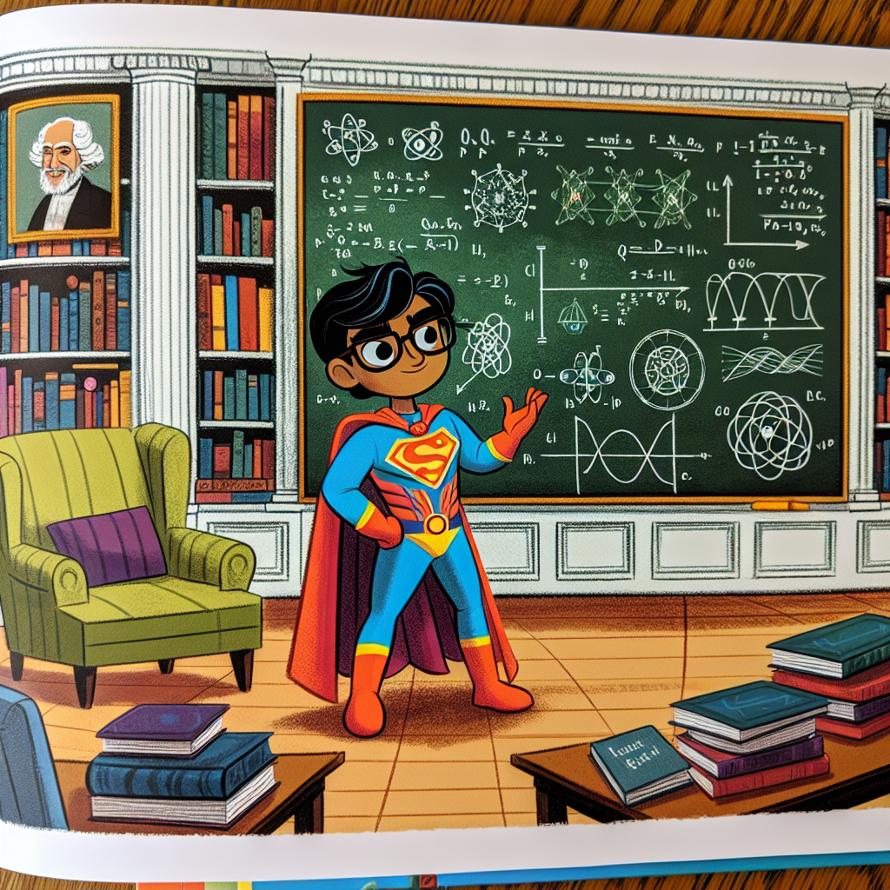
In the children's story book, the young superhero learns to study marine life using generative AI, discovering fascinating underwater organisms and their unique traits. As the superhero progresses through high school and university,
he focuses on topics that align with his passion for ocean exploration. By the time he reaches his PhD studies, he delves into cutting-edge advancements in marine biology, shaping the future of underwater research.
Imagine an illustrated page from a children's story book. In the center, a superhero of South Asian descent, dressed in vibrant colors with a pair of glasses perched on their nose, stands in an academic lounge. They are gesturing to a chalkboard filled with complex equations and diagrams related to a cutting-edge PhD topic in quantum physics - a recent advance like quantum entanglement or string theory. The superhero has a focused expression, indicating they are passionately proposing their topic to unseen listeners. Surrounding the scene are bookcases full of research papers and scientific journals, paintings of historical inventors, and cozy reading chairs.

Slide 9
Thank you for your Participation Today
We hope you enjoyed this experience and find it useful

